Slide 1

COPILOT ACCELERATION TEAM
Building an AI-ready organization
Connecting Customer-Built AI Agent to Microsoft 365 Copilot: The Proxy Agent Pattern
Last updated: 2026-05-21

Slide 2



Meet your host and speakers
Darian Nastvogel
Eric Scherlinger
Julie Chudakova

Slide 3
Meeting Guidelines
The session is open to everyone. Please do not discuss any sensitive topics or Microsoft NDA content.
Avoid adding any AI notetaking agents
Poll questions are optional and subject to Microsoft Privacy Statement (aka.ms/privacy)
We will ask for your input, raise your hand to share and we will call on you.
Please be respectful of others
Have fun!

Slide 4
What we'll cover today
Live demo included
1
Intro
Welcome & overview
5m
2
Topic & Problem
Why bring your own AI agent to Copilot
5m
3
Proxy Agent Sample
Architecture deep-dive
5m
4
Live Demo
Foundry agent in M365 Copilot & GitHub Copilot Skill
15m
5
Wrap up
Key takeaways & resources
5m
6
Q&A
Your questions
15m

Slide 5
Why bring your own AI agent to M365 Copilot?
Three common themes we hear from customers
Existing AI investment
You already operate an AI agent on Foundry, OpenAI, Anthropic, Groq, or LangChain. You want it reachable in M365 Copilot without moving or rebuilding it.
Familiar UI for any AI
Users meet your agent inside Copilot Chat, Word, Outlook, and Teams — the apps they already open every day.
Enterprise-grade integration
built with Microsoft’s identity, compliance, and governance standards from day one.

Slide 6
Customer scenarios
Three patterns we hear at the customer table — same question, different industry
“We already built an AI assistant… can we make it work inside Microsoft 365 Copilot?”
MANUFACTURING
FINANCIAL SERVICES
UI FOR AI
“Downtime Agent”
“Policy & Risk Answers”
“Single Front Door”
“We have an AI that diagnoses machine issues from manuals and sensor logs.”
“We built AI for lending policy interpretation and risk checks.”
“We have several AI assistants across teams, but no single experience.”
Why they want it in Copilot:
Engineers coordinate fixes in Teams and document work in M365 — tool switching during downtime kills speed.
Why they want it in Copilot:
Their relationship managers live in Outlook and Word — they don’t want another portal.
Why they want it in Copilot:
One unified place to go for AI — Copilot as the front door.
Customers are building AI everywhere. The question is always the same — how do we put it where users already work, without huge investment?

Slide 7









Architecture at a glance
Your external AI agent stays put — the toolkit-generated sample fronts it to Copilot
EXTERNAL AI AGENTS
AUTOMATED — M365 AGENTS TOOLKIT
Existing AI investment
Toolkit-generated components
OpenAI
Anthropic
Gemini
LangChain
+ custom stacks
Azure Bot
Proxy Agent
M365 Copilot
EXISTING SURFACE
Service
User
Web UI
Agents SDK
Channel + UX
User
Microsoft | CAT AI Webinars | The Proxy Agent Pattern

Slide 8
A thin relay to your AI agent
Microsoft handles the transport. You own the intelligence.
THE IDEA
Bring your own AI Agent — and keep it yours. The proxy handles auth, streaming, and transport between Microsoft 365 and your agent, so your users get your brand, your experience, and your intelligence in Microsoft 365 Copilot — without worrying about the plumbing.
Your AI agent stays exactly where it is.
THE PROXY HANDLES
Microsoft 365 Copilot message protocol
Bot Service registration and lifecycle
User identity and SSO token exchange
Streaming response chunking
Activity formatting (adaptive cards, citations)
Telemetry, retries, error surfacing

Slide 9



How a single user turn flows
User → M365 Copilot → Bot Service → Proxy Agent → Your AI Agent
User
Sends a question
M365 Copilot
Channel + UX
Bot Service
Agent registrar
Auth Cache
Proxy Agent
SSO, streaming
AI Agent
Foundry, OpenAI, ...
▶
▶
▶
▶
MICROSOFT-OPERATED
YOU DEPLOY & OPERATE THIS
KEY COMPONENTS
M365 Agents SDK
Auth, streaming primitives
App Registration
Identity for the proxy
Managed Identity
No secrets in production

Slide 10
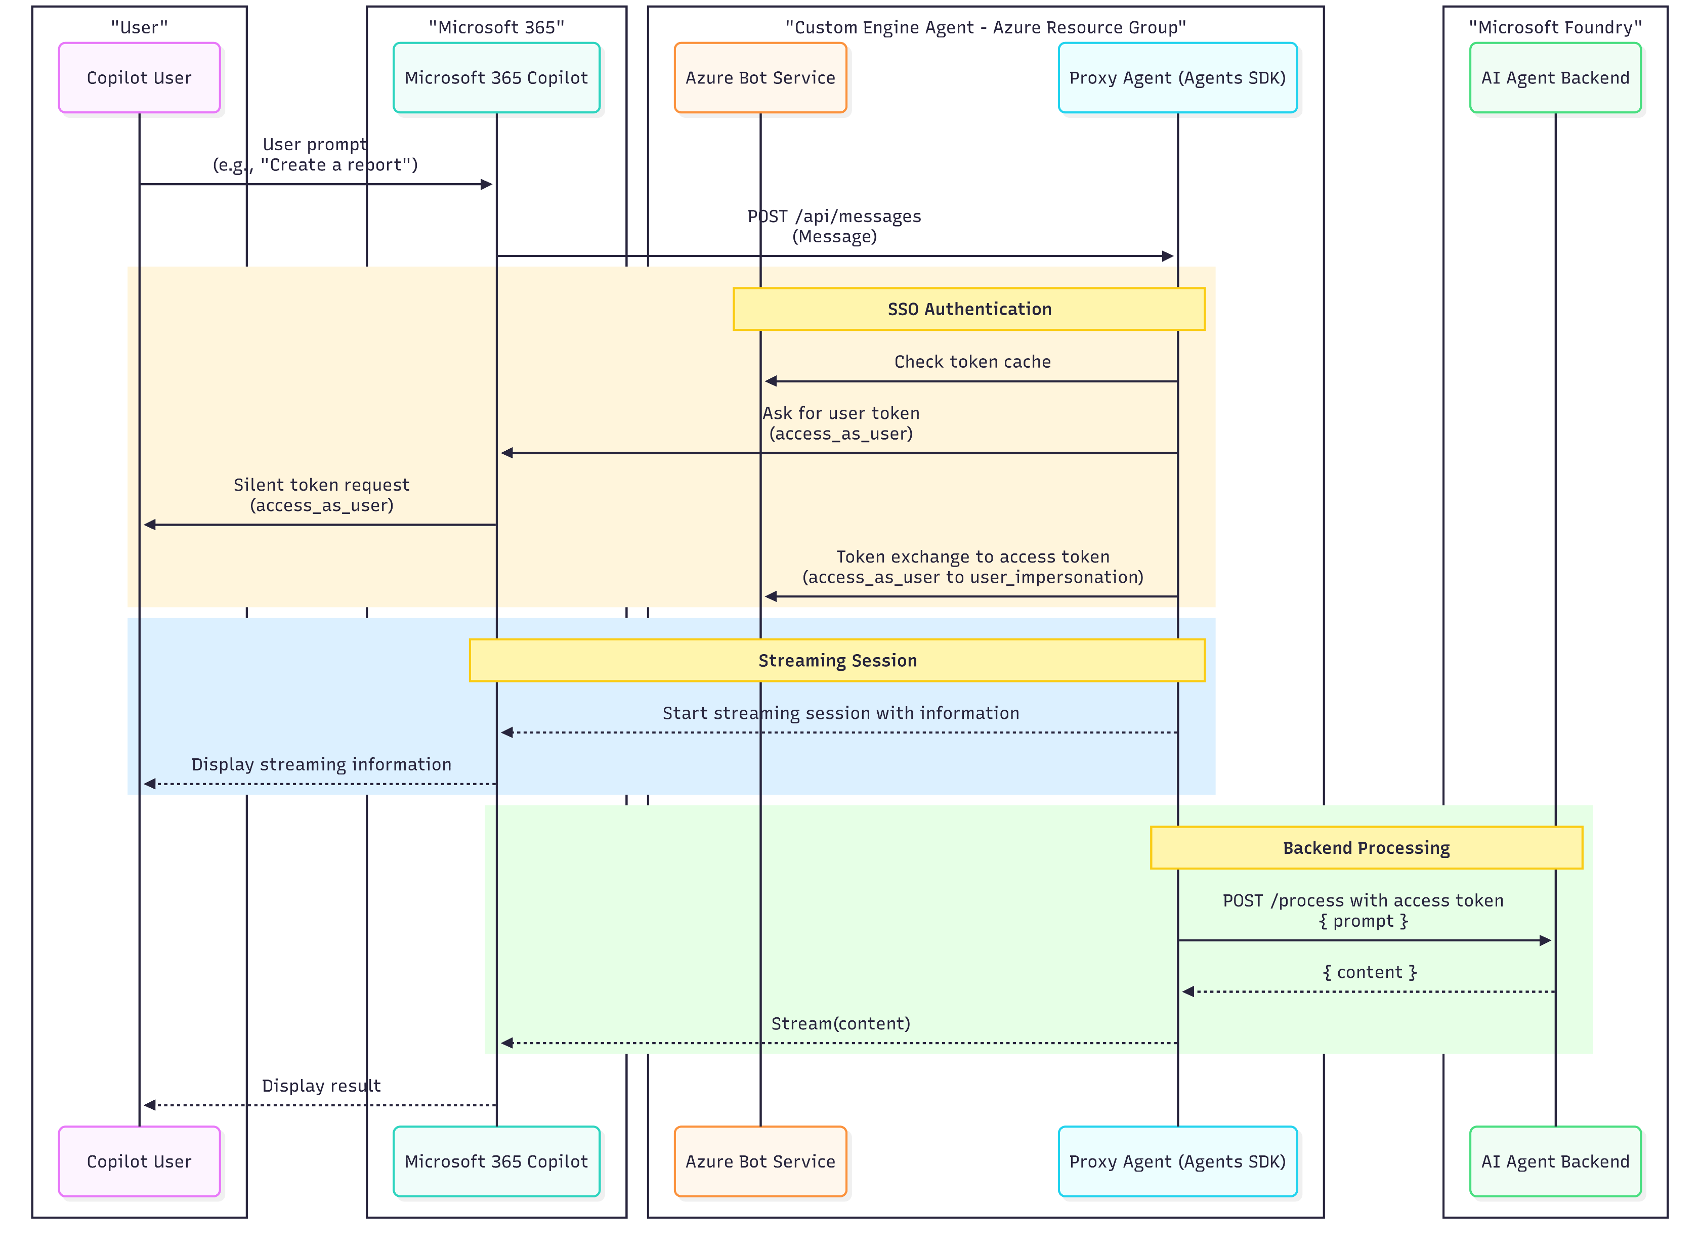
Proxy Agent Deep dive

Slide 11

Proxy Agent Deep dive - SSO

Slide 12
Proxy Agent Deep dive

Slide 13
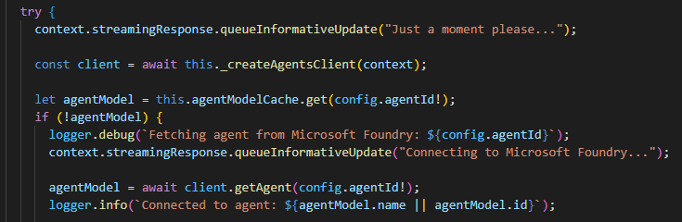
Proxy Agent Deep dive - streaming

Slide 14
Proxy Agent Deep dive

Slide 15

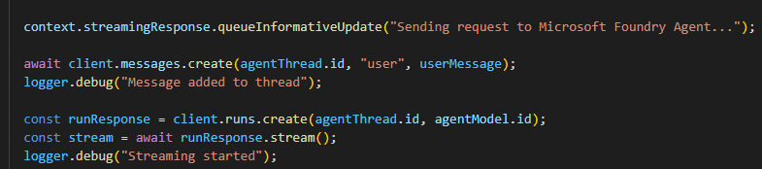
Proxy Agent Deep dive – backend connection

Slide 16



Everything you need to start today
Sample code, walkthrough, and reference docs
GitHub Sample Repo
Node.js + C# +Python implementations with Bicep, manifests, architecture and deployment guide.
Proxy Agent C#
Proxy Agent NodeJS
Proxy Agent Python
Video Walkthrough
Recorded screencast: local dev → Azure deploy → agent swap, narrated end-to-end.
~20 minutes.
GitHub Copilot Skill
GitHub Copilot skill that guides on sample extension for any AI agent is part of the same repo and
Merge in Progress in the Live Repo²

Slide 17



Four things to remember
The talking points we want to stick
1
Backend-agnostic
OpenAI, Anthropic, Groq, LangChain, Foundry, or anything custom. The proxy doesn't care.
2
No secrets in production
Managed Identity plus federated credentials. No keys checked in. No keys to rotate.
3
Swap in one file
src/agent.ts is the only code that touches your AI agent. Everything else is reusable.
4
Watch the pitfalls
Token caching, streaming chunking, manifest configuration — covered in our docs.

Slide 18


Please provide your feedback
Q&A
What would you like to dig into?
Auth & identity in your tenant
Adapting a different AI agent
Deployment & production rollouts
aka.ms/AIWebinars/Feedback

